Slide 1
KEYLOGGER
CAPSTONE PROJECT
Presented By:
R.ARAVINDHAN- Jeppiaar Institute of Technology – B.TECH/ IT

Slide 2
OUTLINE
Problem Statement
Proposed System/Solution
System Development Approach
Algorithm & Deployment
Result
Conclusion
Future Scope
References

Slide 3
PROBLEM STATEMENT
Develop a simple keylogger application using Python's tkinter for the GUI, pynput for capturing keyboard events, and json module for storing the logged keystrokes. The keylogger should start recording keystrokes when the user clicks the "Start" button and stop when the "Stop" button is clicked.

Slide 4
PROPOSED SOLUTION
To address the problem, we propose developing a Python application using the following steps:
Import necessary modules: tkinter for GUI, pynput for capturing keyboard events, and json for data serialization.
Define functions to handle keyboard events (press and release), start and stop the keylogger, and write the logged keystrokes to text and JSON files.
Create a GUI using tkinter with buttons to start and stop the keylogger and a label to display the status.
Bind the start and stop buttons to their respective functions.
Run the tkinter main loop to display the GUI.

Slide 5
SYSTEM APPROACH
Technology Used:
Event Handling: The on_press and on_release functions capture keyboard events and store them in a list.
File Writing: The generate_text_log function writes the keystrokes to a text file, while generate_json_file serializes the keystrokes list to JSON and writes it to a file.
GUI Interaction: Buttons for starting and stopping the keylogger are provided. The status label updates accordingly.
User Interaction: Users can click the "Start" button to initiate keylogging and the "Stop" button to cease it.

Slide 6
ALGORITHM & DEPLOYMENT
Algorithm:
Initialize the GUI elements and global variables.
Define event handlers for keyboard press and release events.
Implement functions to start and stop the keylogger.
Bind the functions to the GUI elements.
Run the tkinter main loop to display the GUI.
Deployment:
Save the Python script with a .py extension.
Ensure necessary modules (tkinter, pynput) are installed.
Execute the script to launch the GUI.
Click the "Start" button to begin keylogging.
Click the "Stop" button to terminate keylogging.

Slide 7
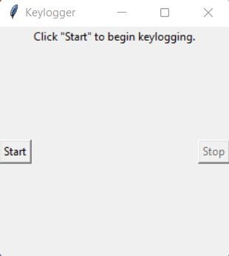
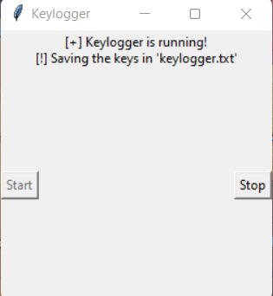
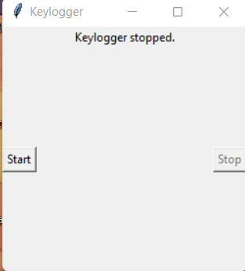
RESULT
The application provides a basic keylogging functionality with a user-friendly GUI. It accurately captures keyboard events and stores them in both text and JSON formats.

Slide 8
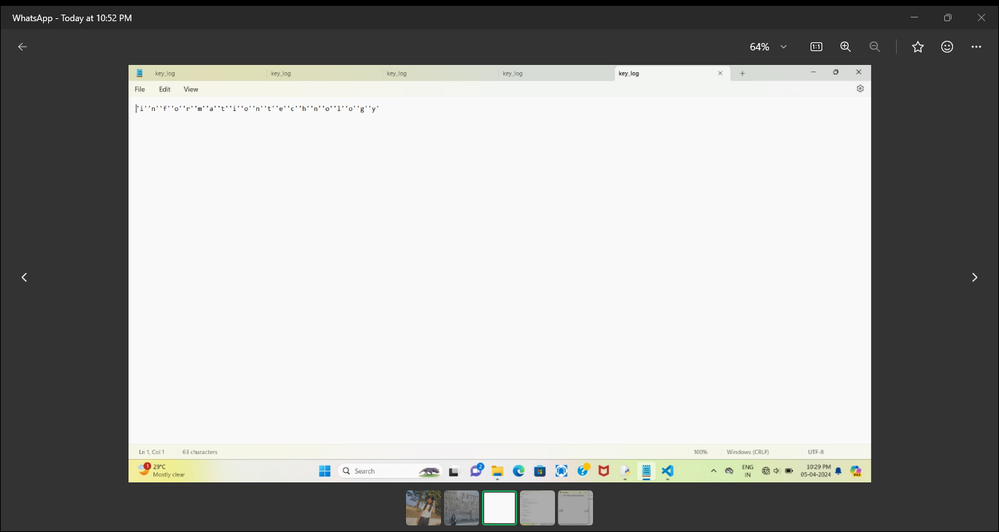
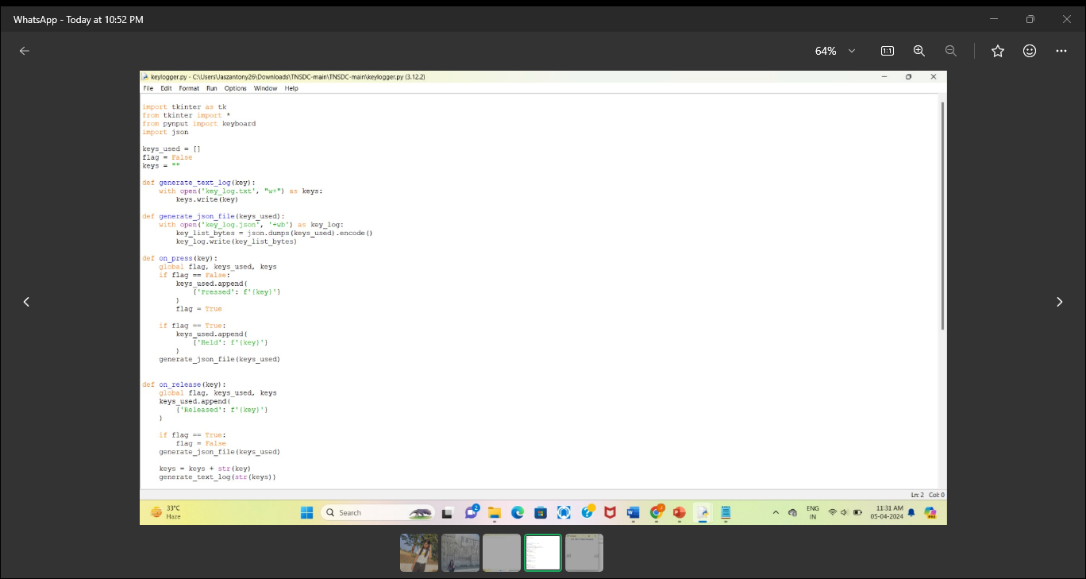
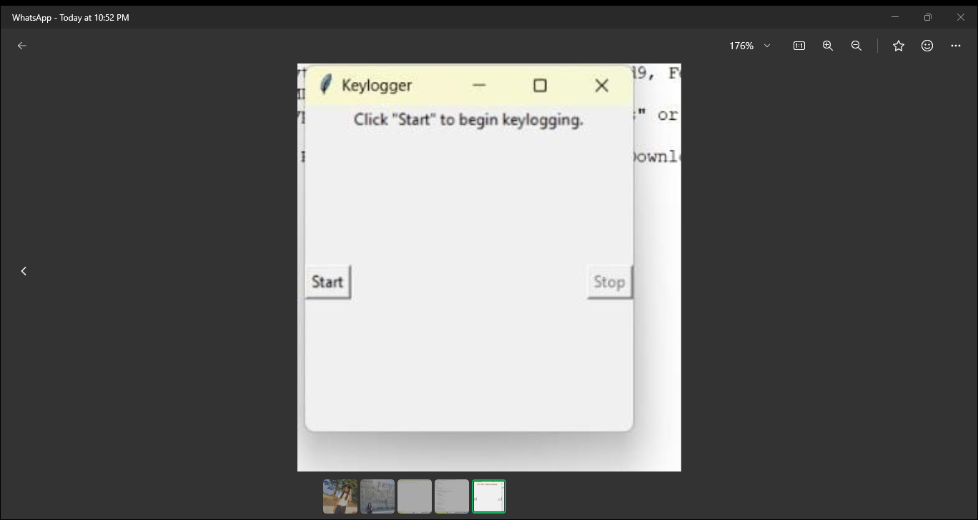
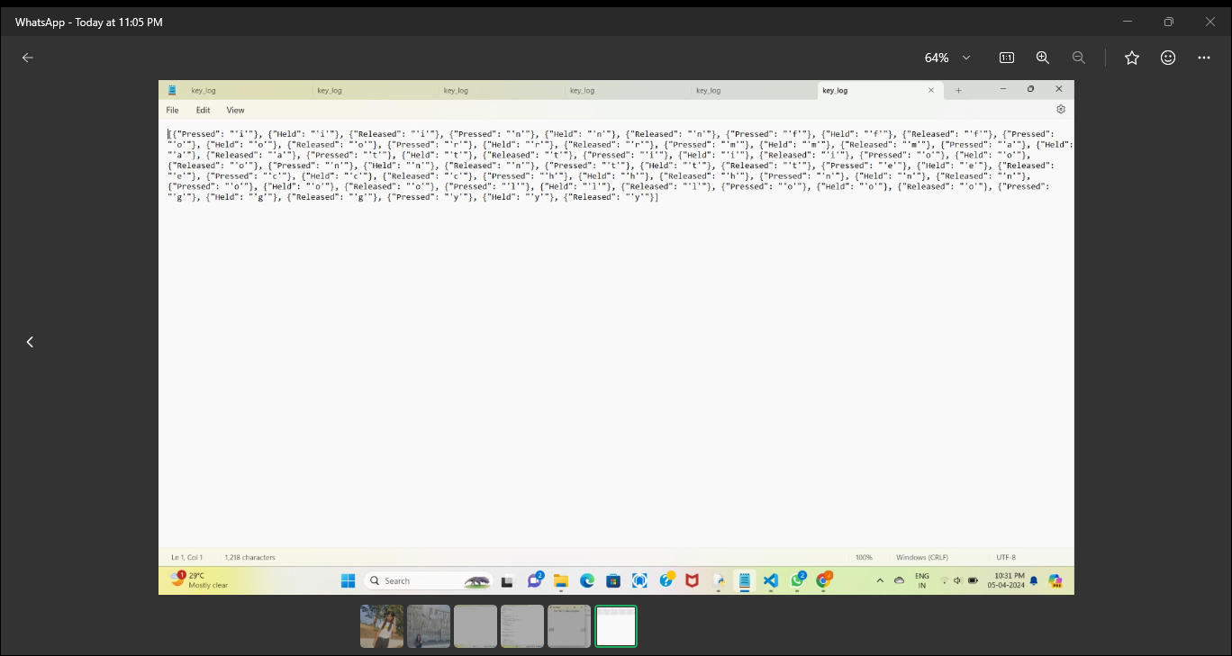
OUTPUT

Slide 9
CONCLUSION
The developed keylogger application fulfills the requirements by effectively capturing keystrokes and providing a simple interface for the user to start and stop keylogging. It demonstrates the integration of GUI elements with keyboard event handling in Python.

Slide 10
FUTURE SCOPE
Enhanced Logging: Implement features such as timestamping and logging additional information.
Security Measures: Integrate encryption for logged data to enhance security.
Remote Monitoring: Enable remote access to view keystroke logs.
User Authentication: Implement user authentication to access logged data.
Cross-Platform Support: Ensure compatibility across different operating systems.

Slide 11
REFERENCES
tkinter Official Documentation
pynput Official Documentation
JSON Official Documentation for Python
For tutorials and further learning, you can explore the following websites:
Real Python
GeeksforGeeks
Stack Overflow

Slide 12
THANK YOU

